Slide 2
Implement an Adobe Digital Publishing Suite Storefront in Experience Manager - L709
James Lockman | Principal Solutions Consultant, Adobe Herman Lee | Solutions Engineer, Ensemble
#AdobeSummit

Slide 3


Herman Lee
Solutions Engineer, Ensemble
hermanl@ensemble.com / @realhermanlee
James Lockman
Creative Workflow Specialist, Adobe
Jlockman@adobe.com / @jameslockman

Slide 4
Customized Branding drives adoption of tablet and mobile apps
#AdobeSummit
Notes:
Readers expect a branded experience in their apps. In addition, personalized experiences result in closer engagement with the reader. This lab will show how to achieve both with Adobe DPS and AEM.

Slide 5
Key Takeaways
1
2
3
DPS Library APIs
DPS Entitlement APIs
Functional storefront
#AdobeSummit
Notes:
We will cover three main topics during this lab: the DPS Library APIs, the DPS Entitlement APIs and finally we’ll build a functional storefront in AEM leveraging these APIs. You will be able to take home the packages that we build, and you’ll have the workbook along with the packages. Before we begin, let’s define what DPS is and how AEM fits into a DPS workflow.

Slide 6











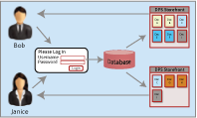
What is DPS?
Make
Distribution
Deploy
Content
Branded Apps
HTML User Interface
Control
Measure
Analytics
Entitlement
Notes:
Adobe Digital Publishing Suite, or DPS, is a platform for delivering offline and online content to readers on tablets.
Content comes from creative tools such as InDesign, business tools such as PPT, but it can also come from AEM. Content gets transformed to a .folio file in InDesign, PPT or AEM for delivery by DPS
Content moves through the distribution services, which are cloud services managed by Adobe. Once published, content becomes available to client apps
Client apps are made using a tool called the App Builder. This is a wizard-driven tool that makes iOS, Android and Windows 8.1 apps. The apps are configurable via checkboxes and customizable via HTML. This lab will focus on the app front end, called the Library, which we will build in AEM.
The client apps can offer login to the reader, which allows the publisher to target specific content to specific readers. DPS uses three APIs that exist under the Entitlement group to control the entitlement process. We will also focus on these APIs during the lab, and we’ll see an example of how to use AEM to manage the connection between a known reader and the content they can see in the library.
We’re at the Digital Marketing Summit, right? What discussion would be complete without Analytics! DPS apps are automatically instrumented with the Analytics SDK, and all folio content is automatically tagged. The upshot is that there is no additional effort to the developer to ensure that the marketer has actionable analytics from each and every DPS app you make.
Analytics allow the content creators to understand the consumption patterns for the content they create. It also can leverage entitlement to show how a known user consumes content. All in all, it’s a very powerful marketing tool wrapped in a content distribution system.
This lab will not touch on content creation. It will only discuss Libraries and Entitlement.

Slide 7

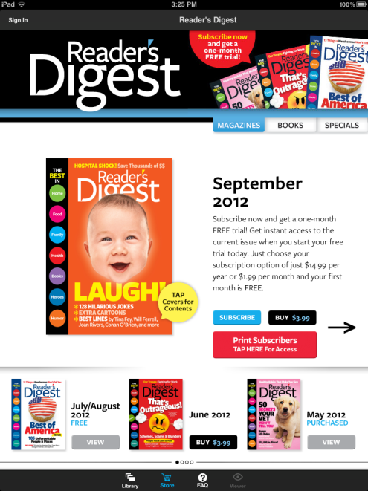
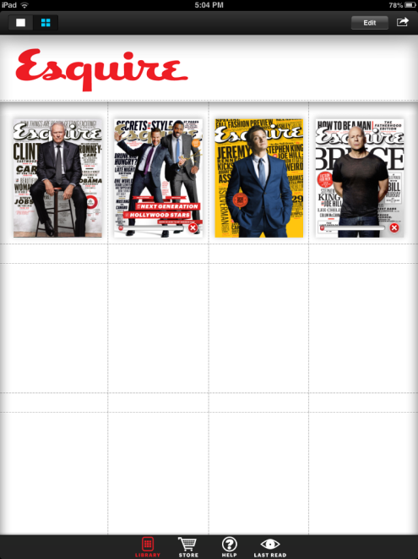
What’s a Custom HTML Slot or Library?
Custom HTML Slot (iOS only)
Create a custom branded and highly designed merchandising view of issues or other digital content
Duplicate ecommerce capabilities using Library and Store APIs
Pull pricing from content marketplace
Custom Library (iOS, Android and Windows 8.1)
Replace default library with custom design
Leverage HTML, JS and CSS
Populate library template using Library and Store APIs
Notes:
All DPS Apps have two modes: the Library mode and the Reading mode. The Reading mode is used to display the folios that the reader downloads to the app. The Library mode is where the reader discovers and downloads content. It’s also where the publisher can incorporate online and offline HTML code to provide a highly customized experience for the reader.
Let’s look deeper at how we can customize the user experience in a DPS app. In iOS apps, there are two Library modes: the Library and Custom HTML slots. In Android and Windows app, there’s just the Library.
The Library is typically where a reader would go to see the list of content that’s available on their device. It can also display additional behaviors and can be customized using HTML. The Library code is embedded in the app and runs whether the user is online or offline. You can blend online and offline code, too, but you should always include a fallback for when the user is offline. All DPS apps (iOS, Android, and Windows 8.1) have a Library.
A Custom HTML Slot is an iOS only feature. It’s basically a Library, but it can be accessed from the moustache at the bottom of the screen. In addition, you can label a storefront so that you can navigate to it from content or from another Custom HTML Slot. Custom HTML Slots are sometimes called Storefronts.
Both Libraries and Custom HTML Slots can use the Library and Store API. This set of functions enable the Library or Custom HTML Slot to access the DPS backend to (this is not an exhaustive list):
Get lists of available content from the DPS Service
Get pricing and subscription information from app marketplaces such as iTunes and Google Play
Read metadata about that available content for the purpose of displaying the content to the reader
Log in to and interact with external CRM systems such as salesforce.com
Access the device’s hardware such as location and accelerometer
Log in to an external Entitlement system to determine which subset of available content a reader can “see” in their app
In this lab, we will build a library using AEM. It will be an ONLINE library, which means that the device will need to be connected to the Internet in order for the library to work. In practice, you would bundle the published code into a ZIP file and embed it into the DPS app. Since this lab isn’t about app building, we’ll use another app to test our work on a device. We will also look at how Entitlement works and study some example Entitlement code. This is hard to test here in a lab without having access to DPS backend services, but you will be able to use the example code to implement on your own DPS account.

Slide 8
Foundations
1
2
3
DPS Library APIs
DPS Entitlement APIs
Functional storefront
#AdobeSummit
Notes:
Let’s begin with the DPS Library APIs.

Slide 9
DPS Library APIs
http://www.adobe.com/go/dps-library-store-api
You must include one of the following files with your custom HTML to access the APIs.
AdobeLibraryAPI.js http://www.adobe.com/devnet-docs/digitalpublishingsuite/DPSViewerSDK-2.32/AdobeLibraryAPI.js
AdobeLibraryAPI.min.js http://www.adobe.com/devnet-docs/digitalpublishingsuite/DPSViewerSDK-2.32/AdobeLibraryAPI.min.js
Example code is available at the Developer Network
http://www.adobe.com/devnet/digitalpublishingsuite/custom-storefronts-and-libraries.html
Store Configurator is a good place to start for standalone Libraries
http://dpsapps.adobe.com/store_configurator/

Slide 10
How to implement in AEM
It’s just JS, so template is easy to manage
Ensure that you reference the library in your template
Develop components that use the API
Include the JS file as part of your rollout
Publish to Publish instance for public access
For App Builder, two strategies:
include index that refers Viewer to your Publish instance
Package published code and save as .zip for embedding in App for offline use

Slide 11
Foundations
1
2
3
DPS Library APIs
DPS Entitlement APIs
Functional storefront
#AdobeSummit

Slide 12
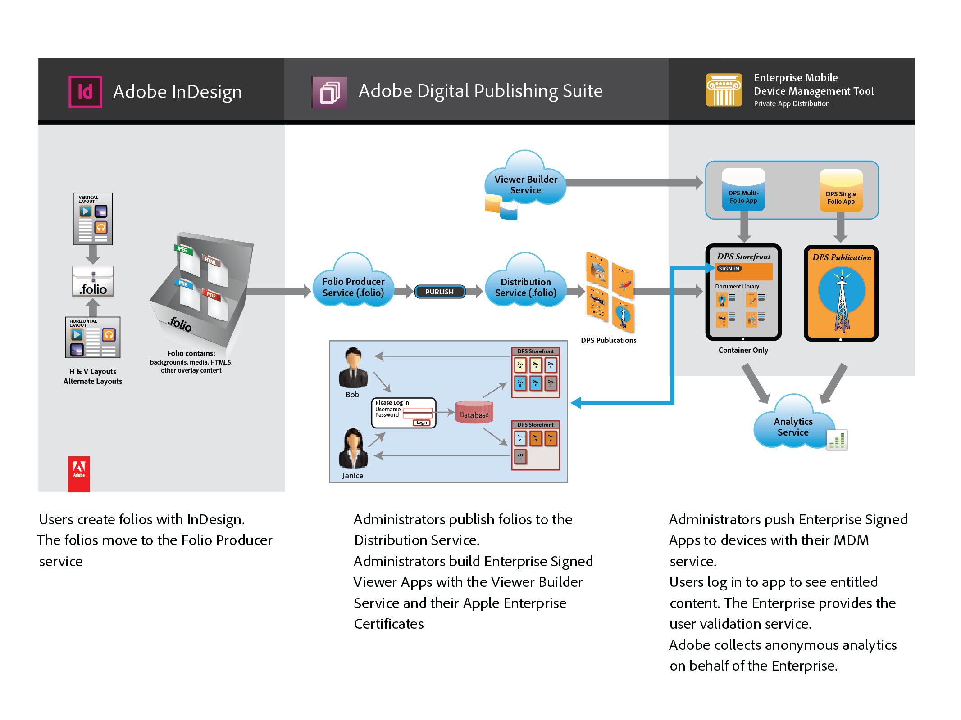
Behind the scenes

Slide 13
DPS Entitlement APIs
Three RESTful APIs to implement in AEM
/SignInWithCredentials
/RenewAuthToken
/entitlements
API Documentation
http://download.macromedia.com/pub/developer/dps/entitlement/direct-entitlement-api.pdf
Entitlement White Paper
http://wwwimages.adobe.com/content/dam/Adobe/en/products/digital-publishing-suite-enterprise/pdfs/dps-entitlement-wp-ue.pdf

Slide 14
/SignInWithCredentials
Method: POST
Include XML document in request:
<credentials>
<emailAddress>joe@abc.com</emailAddress>
<password>password</password>
</credentials>
Success Results:
HTTP 200 OK
Body:
<result httpResponseCode=”200”>
<authToken>some_token_you_define</authToken>
</result>
Error Results:
HTTP 401 Unauthorized Body:
<result httpResponseCode=”401” errorCode=””/>
Query Parameter | Required | Type | Description
appId | no | string | The ID of the viewer application
appVersion | no | string | Version of the viewer application
uuid | no | string | Device UUID
Return |  | Type | Description
authToken |  | xml | An authentication token used to identify the authenticated user in future calls to the third party system.

Slide 15
/RenewAuthToken
Parameter | Required | Type | Description
authToken | yes | string | AuthToken returned by signInWithCredentials
appId | no | string | The id of the viewer application
appVersion | no | string | Version of the viewer app.
uuid | no | string | Device UUID
Return |  | Type | Description
authToken |  | xml | An authentication token used to identify the authenticated user in future calls to the third party system.
Method: GET
Include old authToken in the request
Success Results:
HTTP 200 OK Body:
<result httpResponseCode=”200”>
<authToken>new_auth_token_you_define</authToken>
</result>
Error Results:
HTTP 401 Unauthorized Body:
result httpResponseCode=”401”/>

Slide 16
/entitlements
Method: POST
Request Body: The request can contain an xml document. The document lists the productIds and coverDates of the folio for which the caller needs entitlement status.
<folios>
<folio>
<productId>com.company.sales.1</productId>
<coverDate>2011-10-11T20:49:40Z</coverDate>
</folio>
<folio>
<productId>com.company.hr.3</productId>
<coverDate>2011-11-11T20:49:40Z</coverDate>
</folio>
</folios>
It is not necessary to send a list in the request to /entitlements. You always need to send the authToken as part of the POST parameters.
Parameter | Required | Type | Description
authToken | yes | string | The authToken returned by signInWithCreden- tials.
appId | no | string | The id of the viewer application
appVersion | no | string | Version of the viewer application.
uuid | no | string | Device UUID
Return |  | Type | Description
entitlement list |  | xml | The list of issues the user is entitled to.
Notes: appId, appVersion and uuid should be treated as optional by the entitlement server. New viewers will always send this information, but older viewers will not.

Slide 17
/entitlements
Example Success:
HTTP 200 OK
Body:
<result httpResponseCode=”200”>
<entitlements>
<productId subscriberType=”print” subscriberId=”a1234”>com.company.sales.1</productId>
<productId subscriberType=”print” subscriberId=”a1234”>com.company.hr.3</productId>
<entitlements>
</result>
Auth Token Invalid Error Results:
HTTP 401 Unauthorized Body:
Body:
<result httpResponseCode=“401” />
Parameter | Required | Type | Description
authToken | yes | string | The authToken returned by signInWithCreden- tials.
appId | no | string | The id of the viewer application
appVersion | no | string | Version of the viewer application.
uuid | no | string | Device UUID
Return |  | Type | Description
entitlement list |  | xml | The list of issues the user is entitled to.
Notes: The productId should uniquely identify an issue and it should be the same ID that was assigned in the bundler when the issue was uploaded to the fulfillment server. This same ID should also be used to register the issue with the Apple Store for single issue in app purchase.

Slide 18


R30+ Direct Entitlement call flow
ES
Integrator
DS
Folio[]
SignInWithCredentials
authToken
authenticateDevice (authToken)
entitlements (authToken)
401
renewAuthToken (authToken)
authToken
entitlements (authToken)
productId[]
entitlements / authToken
© 2014 Adobe Systems Incorporated. All Rights Reserved.

Slide 19
Foundations
1
2
3
DPS Library APIs
DPS Entitlement APIs
Functional storefront
#AdobeSummit

Slide 20
Hands On
James Lockman
jlockman@adobe.com
Twitter: @jameslockman
LinkedIn: jameslockman
www.linkedin.com/in/jameslockman
Herman Lee
hermanl@ensemble.com
Twitter: @realhermanlee
LinkedIn: herman-lee
ca.linkedin.com/pub/herman-lee/8a/416/680

Slide 21
Call To Action
1
2
3
DPS Library APIs
Customize display of available content
DPS Entitlement APIs
Granular access control for DPS content
Functional Storefront
Uses Library and Entitlement APIs for full app customization
#AdobeSummit

Slide 22
Q&A
James Lockman
jlockman@adobe.com
Twitter: @jameslockman
LinkedIn: jameslockman
www.linkedin.com/in/jameslockman
Herman Lee
hermanl@ensemble.com
Twitter: @realhermanlee
LinkedIn: herman-lee
ca.linkedin.com/pub/herman-lee/8a/416/680
Notes:
hermanl@ensemble.com / @realhermanlee

Slide 23





Take the Survey to WIN!
(“surveys” section of mobile app)
$10
$100
$100
SKI
Gift Card
Gift Card
Gift Card
Swag
Every Session
Tuesday
Wednesday
Thursday

Slide 24

adobe.com/go/summit2015portal

